Slide 1
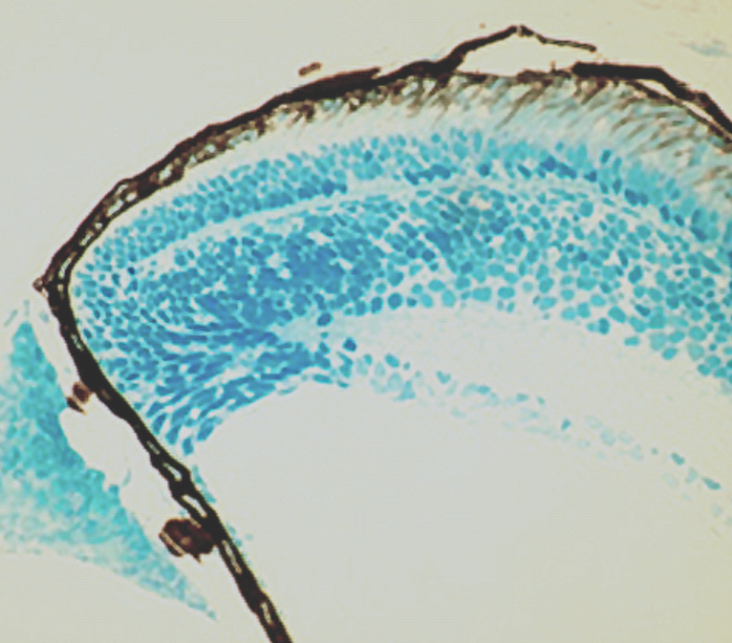
Figure 2
A
CMZ-Central
CMZ-Middle
RPE
CMZ-Peripheral
B
RPE
OLM
ONL
OPL
INL
IPL
GCL
bv
Neural
Retina
Pigmented
Ciliary epithelium
Non-pigmented
Ciliary epithelium (CE)
CMZ
CE

